Slide 1
Learn JavaScript with fun, build an UFO hunter game DOM, the Document Object Model

Slide 2
DOM overview
When a web page is loaded, the browser creates a Document Object Model (DOM) of the page. It represents the page so that programs can change the document structure, style, and content.
The DOM is an object-oriented representation of the web page, which can be modified with a scripting language such as JavaScript.
The DOM represents a document with a logical tree. Each branch of the tree ends in a node, and each node contains object

Slide 3
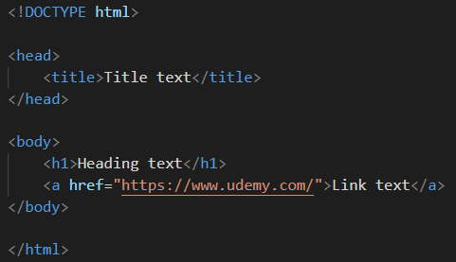
DOM tree of objects
The HTML DOM document object is the owner of all other objects in your web page.
document
Root element:
<html>
Element:
<head>
Element:
<title>
head
Text:
”Title text”
Element:
<body>
body
Element:
<h1>
Text:
”Heading text”
DOM tree
code
Element:
<a>
Attribute:
href
Text:
”Link text”

